Slide 2
Handling asynchronicity in Javascript in 2018

Slide 3
Michel Vollebregt

Slide 4
Contents
The problem
Promises
Observables
What to use?

Slide 5
The problem
Your JavaScript runs in a single thread in the browser
Don’t block!

Slide 6
Example: most recent repo
What is the most recent GitHub repo I pushed to?
http call
JSON

Slide 7
promises

Slide 8
Promises
const endpointUrl =
'https://api.github.com/users/mvollebregt/repos?sort=pushed’;
fetch(endpointUrl);
fetch returns a Promise

Slide 9
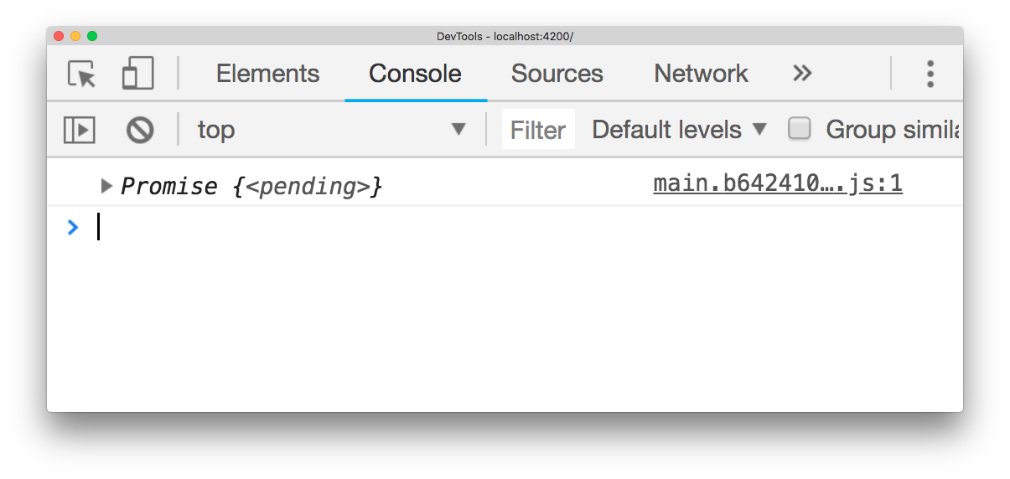
Promises
fetch(endpointUrl).then(response =>
console.log(response.json())
);
result.json() returns another Promise

Slide 10
Promises
fetch(endpointUrl).then(response =>
response.json()
).then(repos =>
console.log(repos[0].name)
);

Slide 11
Async / await
Notes:
Async / await is available since EcmaScript 2017

Slide 12
async / await
fetch(endpointUrl)
response.json()
console.log(repos[0].name)
Notes:
Async / await is available since EcmaScript 2017

Slide 13
async / await
console.log(repos[0].name)
fetch(endpointUrl)
response.json()
Notes:
Async / await is available since EcmaScript 2017

Slide 14
async / await
const response = await
const repos = await
console.log(repos[0].name)
fetch(endpointUrl)
response.json()
Notes:
Async / await is available since EcmaScript 2017

Slide 15
async / await
function getLatestRepo() {
const response = await
const repos = await
return repos[0].name;
}
fetch(endpointUrl)
response.json()
Notes:
Async / await is available since EcmaScript 2017

Slide 16
async / await
function getLatestRepo() {
const response = await
const repos = await
return repos[0].name;
}
async
fetch(endpointUrl)
response.json()
Notes:
Async / await is available since EcmaScript 2017
It also works with regular try / catch.

Slide 17
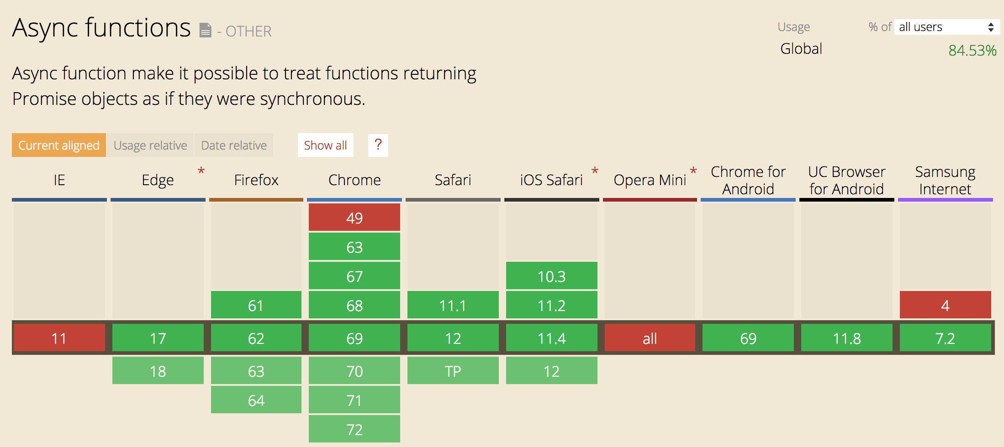
Browser support
Source: caniuse.com
It does not matter if you transpile your code!
Notes:
Async / await is available since EcmaScript 2017

Slide 18
pitfalls

Slide 19
Example: comparing repos
I have three friends.
Who did the most recent push?

Slide 20
Comparing repos
const myRepo = await getLatestRepo('mvollebregt’);
const myFriendsRepo = await getLatestRepo('ilionx’);
const myOtherFriendsRepo = await getLatestRepo('qnh’);
if (myRepo.pushed_at > myFriendsRepo.pushed_at
&& myRepo > myOtherFriendsRepo.pushed_at) {
console.log('I won!’);
}

Slide 21
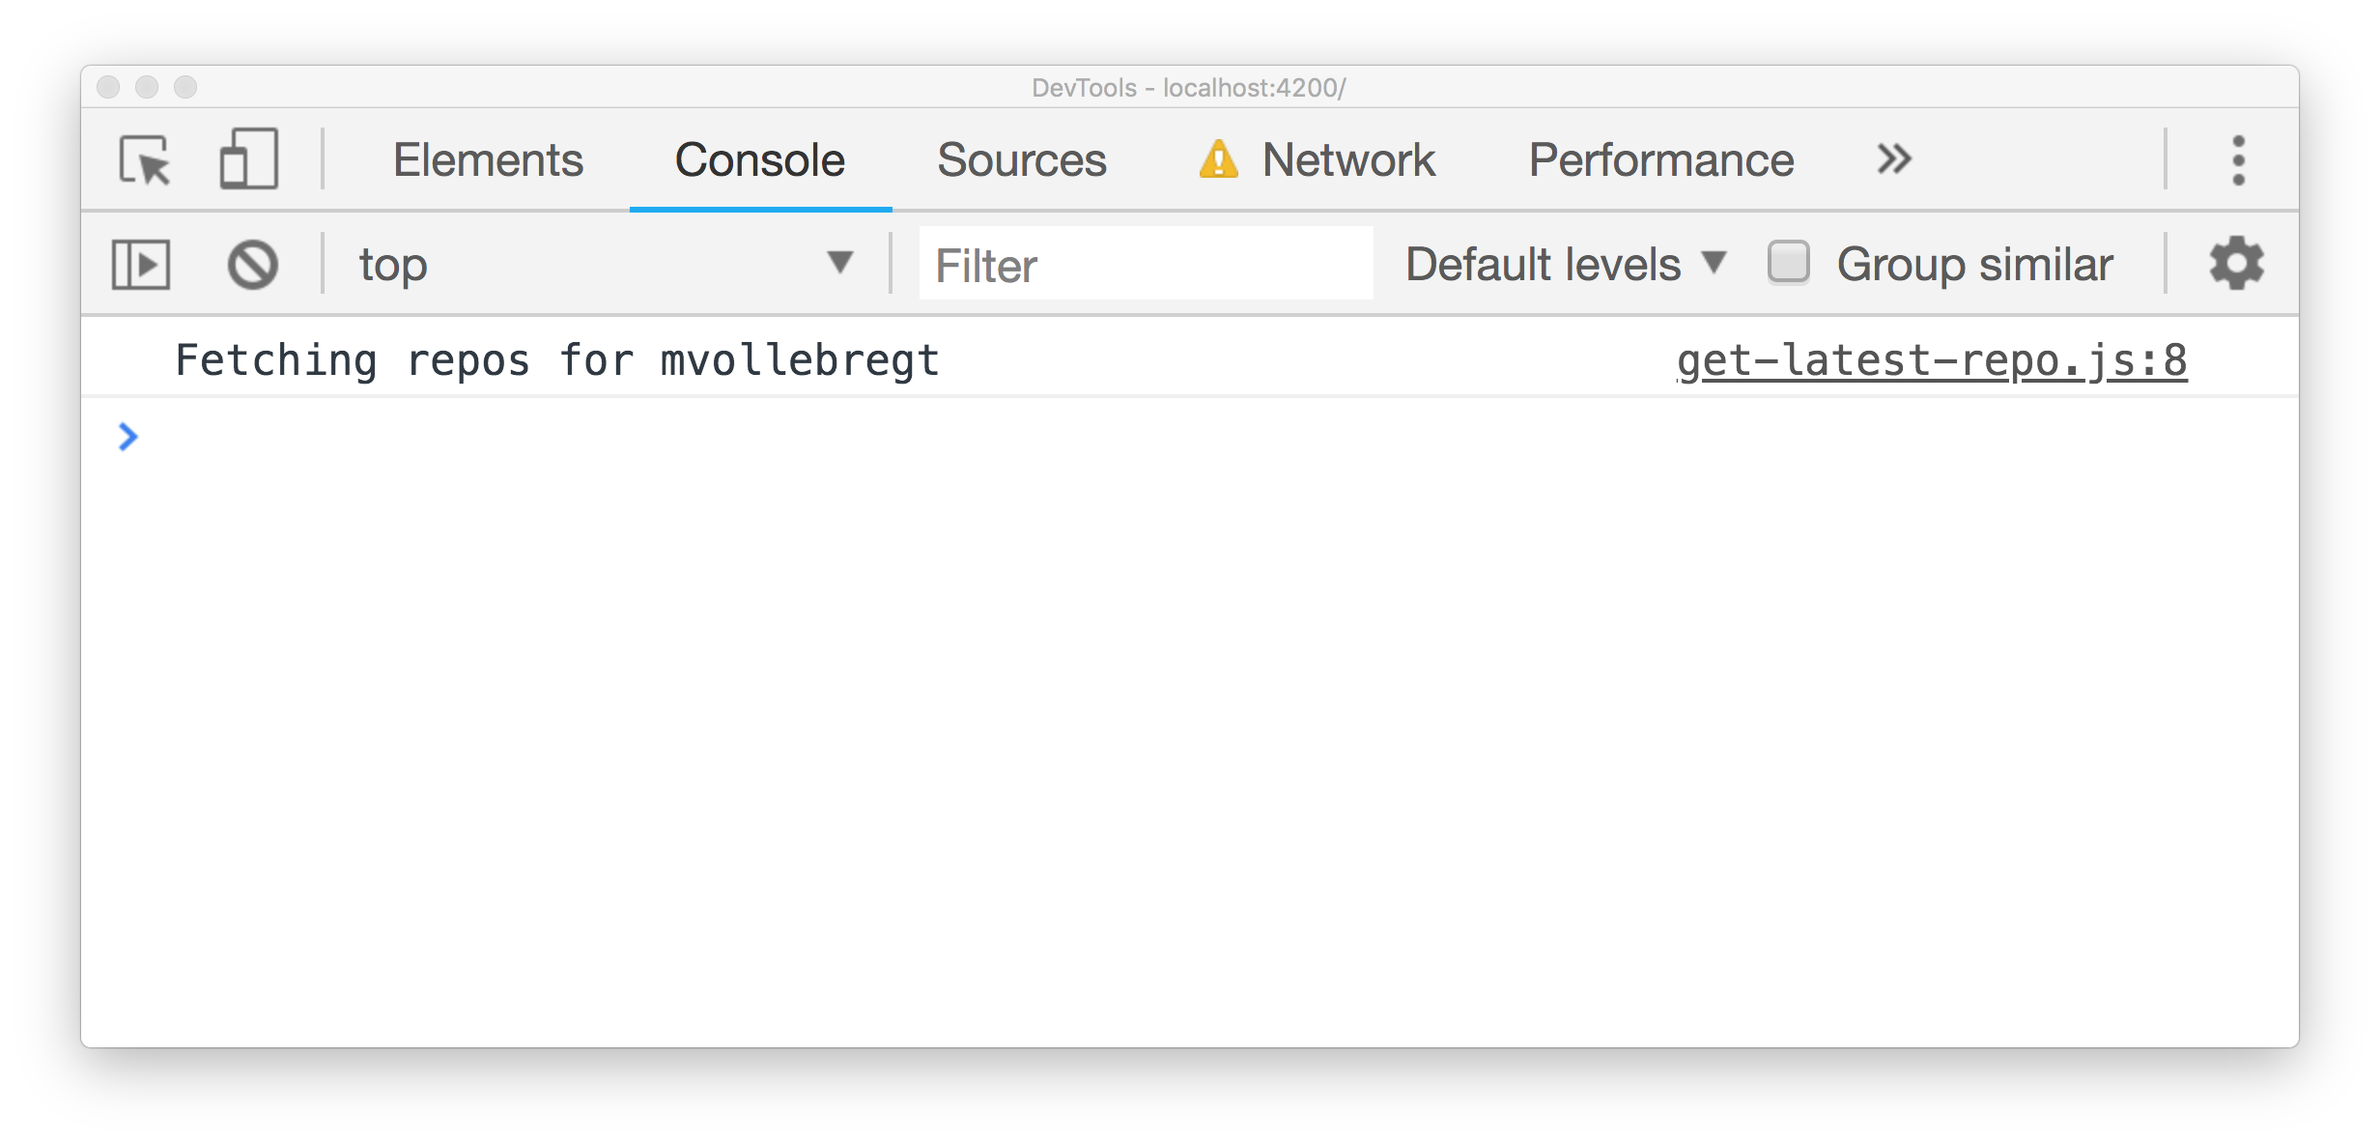
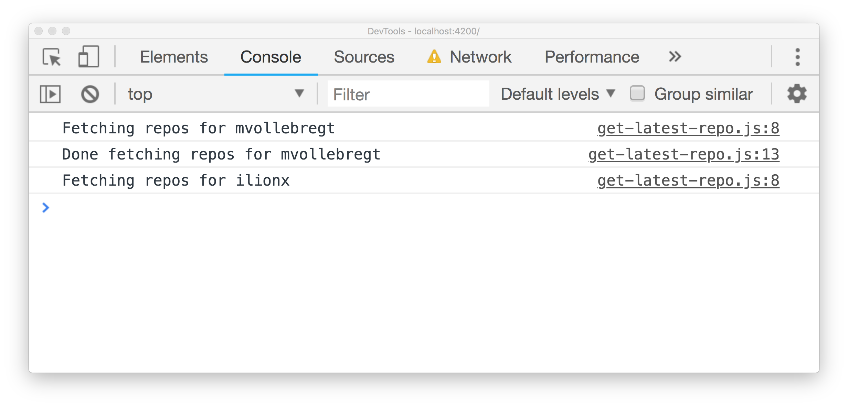
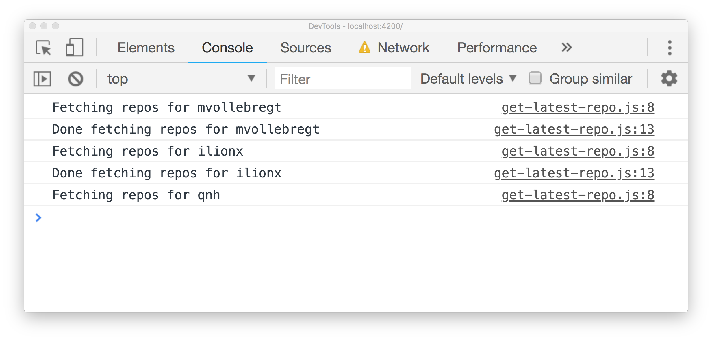
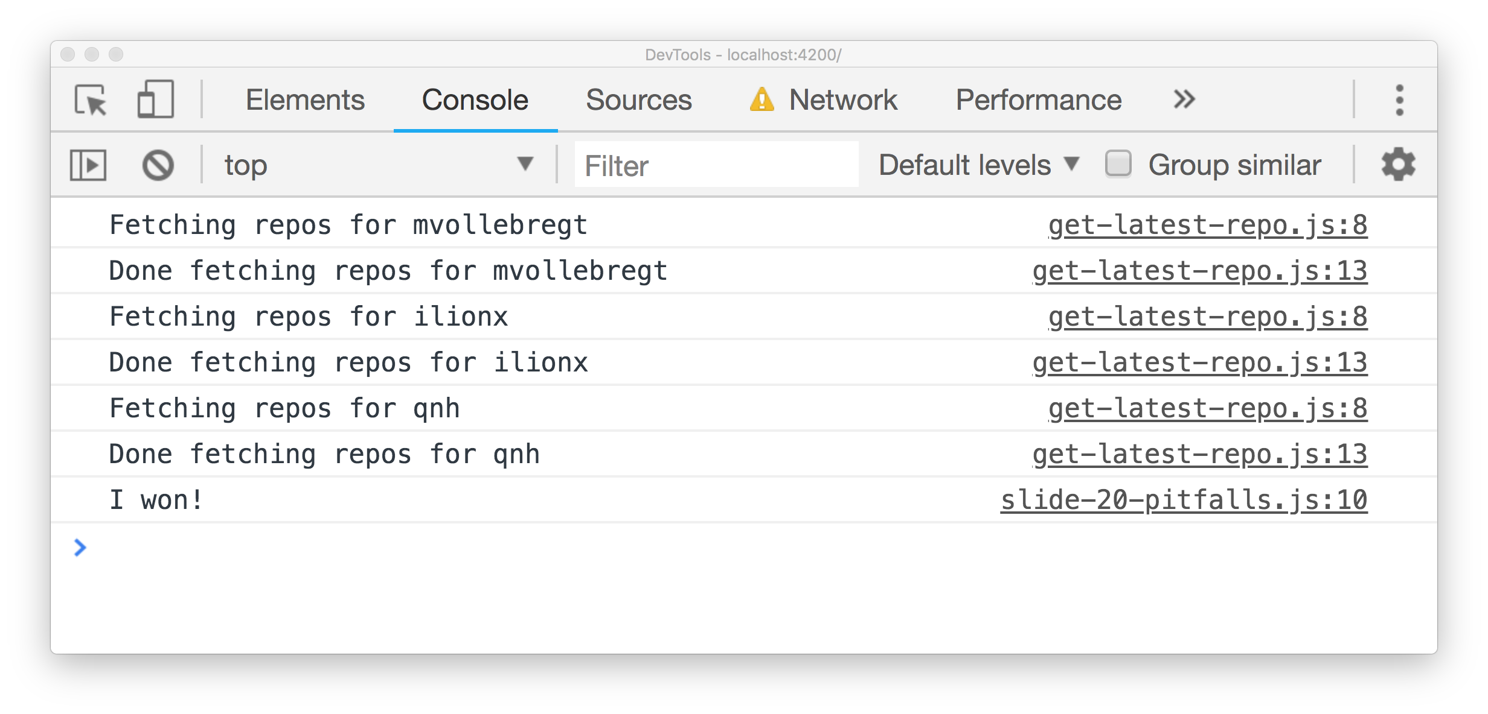
Comparing repos
const myRepo = await getLatestRepo('mvollebregt’);
const myFriendsRepo = await getLatestRepo('ilionx’);
const myOtherFriendsRepo = await getLatestRepo('qnh’);
if (myRepo.pushed_at > myFriendsRepo.pushed_at
&& myRepo > myOtherFriendsRepo.pushed_at) {
console.log('I won!’);
}

Slide 22
Promise.all to the rescue
const myRepo = await
const myFriendsRepo = await
const myOtherFriendsRepo = await
getLatestRepo('mvollebregt’),
getLatestRepo('ilionx’),
getLatestRepo('qnh')

Slide 23
Promise.all to the rescue
getLatestRepo('mvollebregt’),
getLatestRepo('ilionx’),
getLatestRepo('qnh')

Slide 24
Promise.all to the rescue
await Promise.all([
]);
getLatestRepo('mvollebregt’),
getLatestRepo('ilionx’),
getLatestRepo('qnh')

Slide 25
Promise.all to the rescue
const [myRepo, myFriendsRepo, myOtherFriendsRepo] =
await Promise.all([
]);
getLatestRepo('mvollebregt’),
getLatestRepo('ilionx’),
getLatestRepo('qnh')

Slide 26
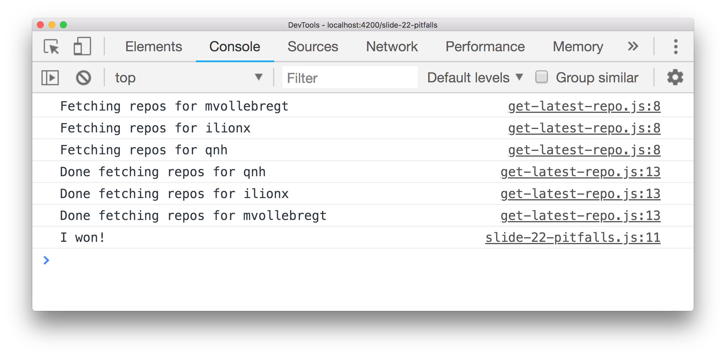
Promise.all to the rescue
const [myRepo, myFriendsRepo, myOtherFriendsRepo] =
await Promise.all([
]);
getLatestRepo('mvollebregt’),
getLatestRepo('ilionx’),
getLatestRepo('qnh')

Slide 27
Recap: async /await
Syntactic sugar for Promises
Built into JavaScript
Imperative coding style
Easy to read code
Emit one value

Slide 28
Bonus
Works with normal try /catch
Works with anything that implements then, not just Promises

Slide 29
observables

Slide 30
Observables
Promises on steroids
Observable emits stream of values over time
Manipulate and combine with operators
Provided by library RxJS
Angular

Slide 31
Observables: examples
Http response
User events
Data changes
State changes
All other kinds of events

Slide 32
Example: http
httpClient.get(endpointUrl)
httpClient returns an Observable

Slide 33
Example: http
httpClient.get(endpointUrl).subscribe(
);

Slide 34
Example: http
httpClient.get(endpointUrl).subscribe(repos =>
console.log(repos[0].name)
);

Slide 35
Example: multiple values
timer(0, 1000)
emits a value every second

Slide 36
Example: multiple values
timer(0, 1000).subscribe(value => console.log(value))

Slide 37
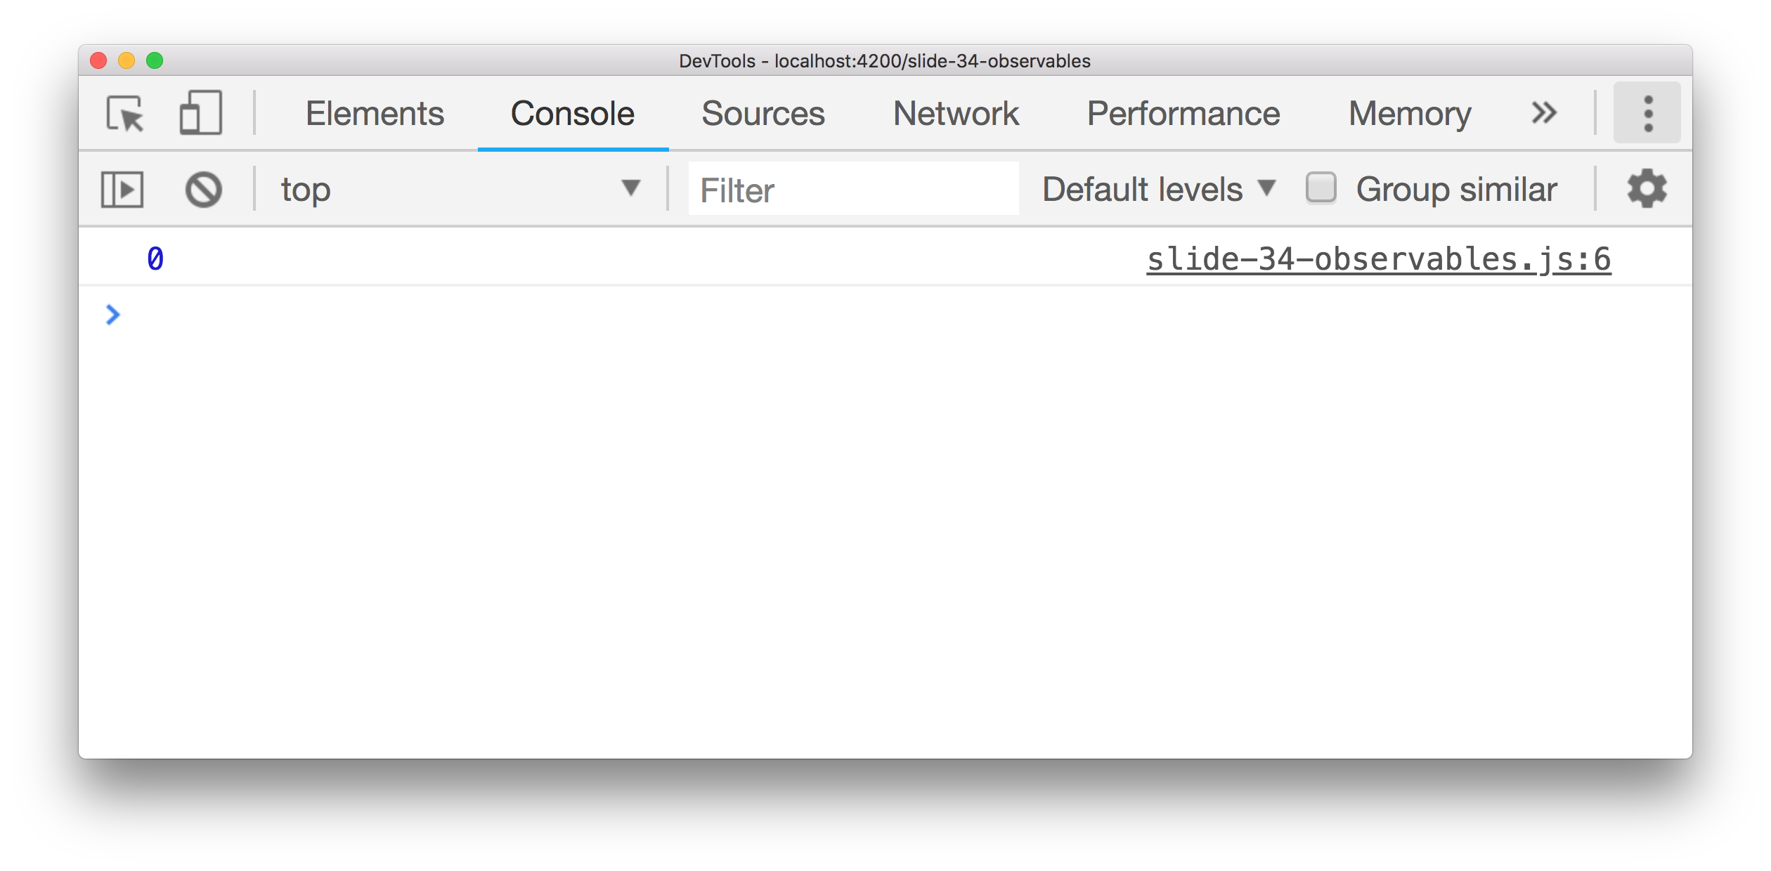
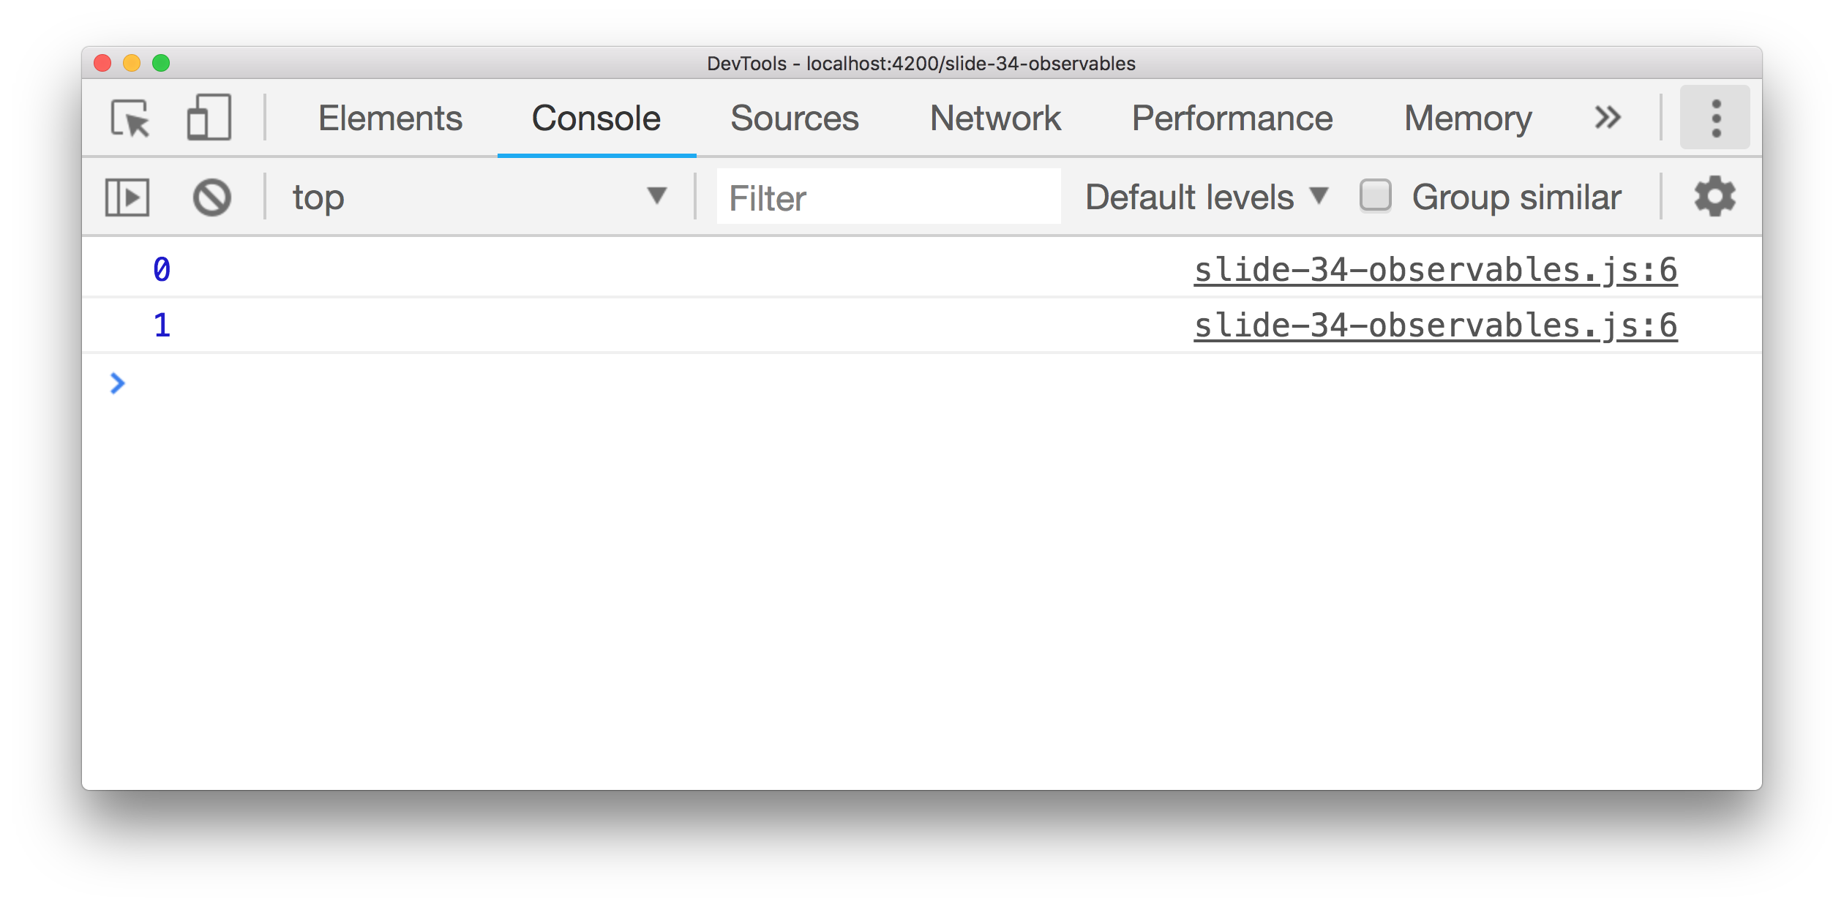
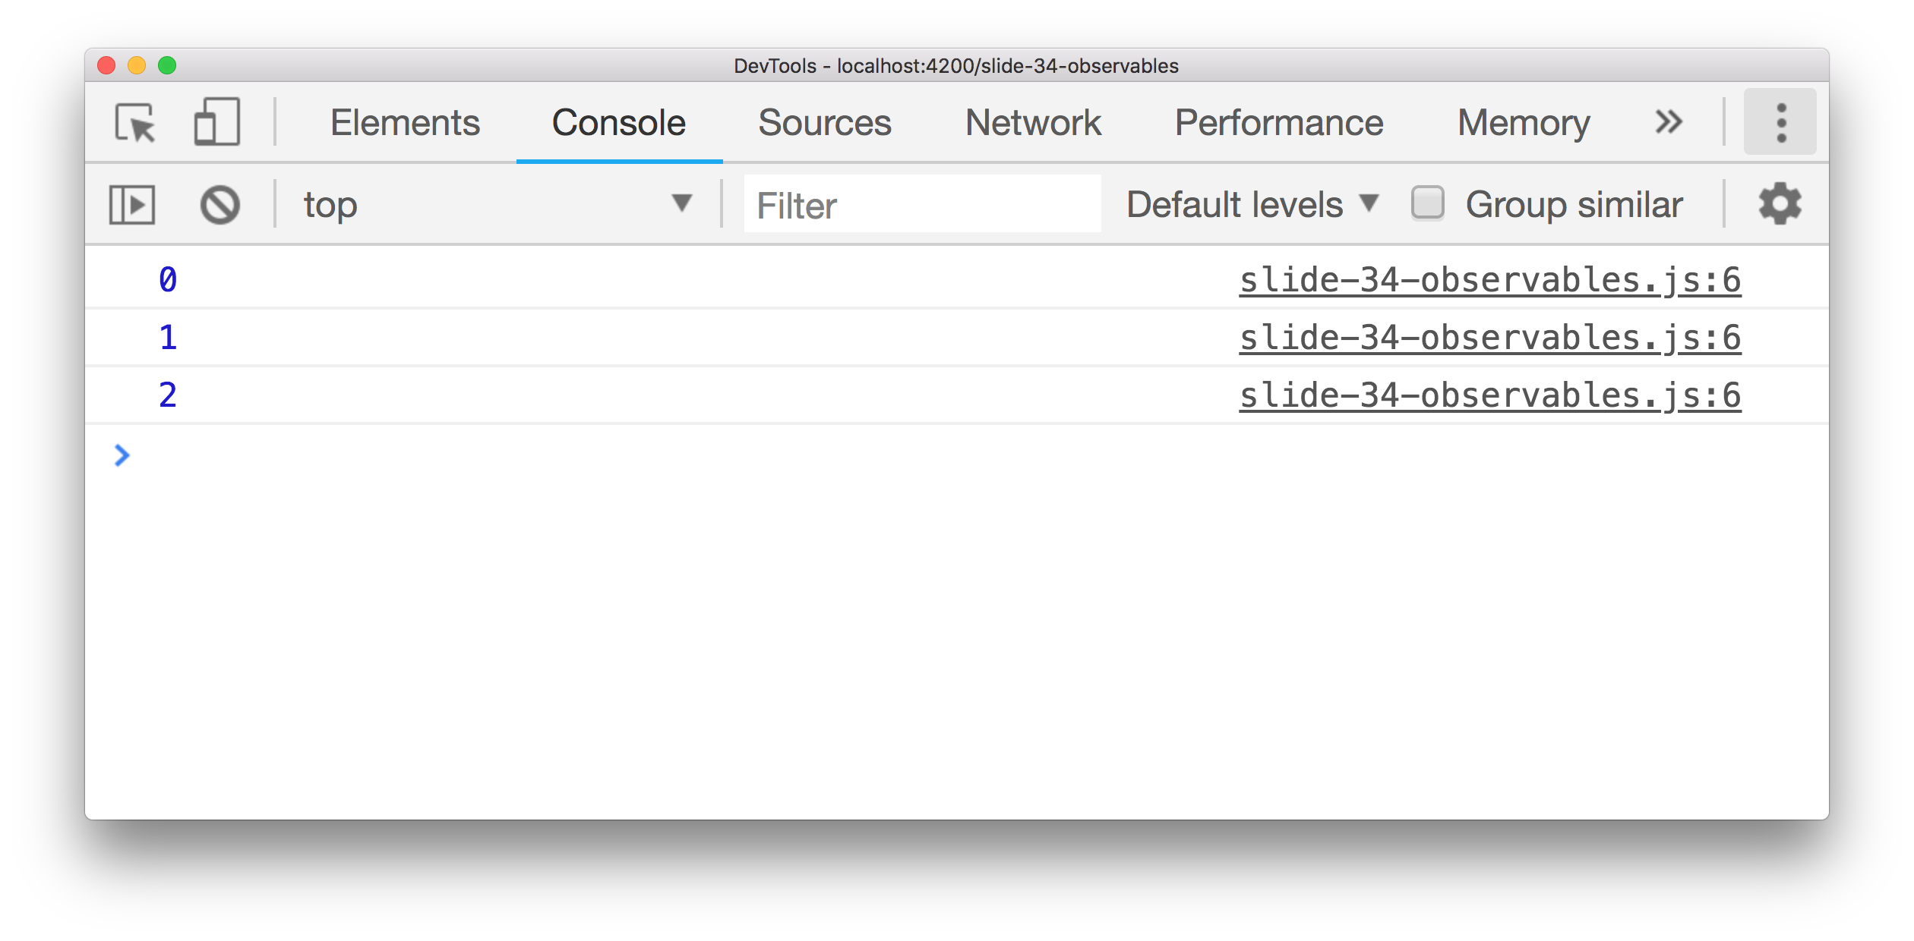
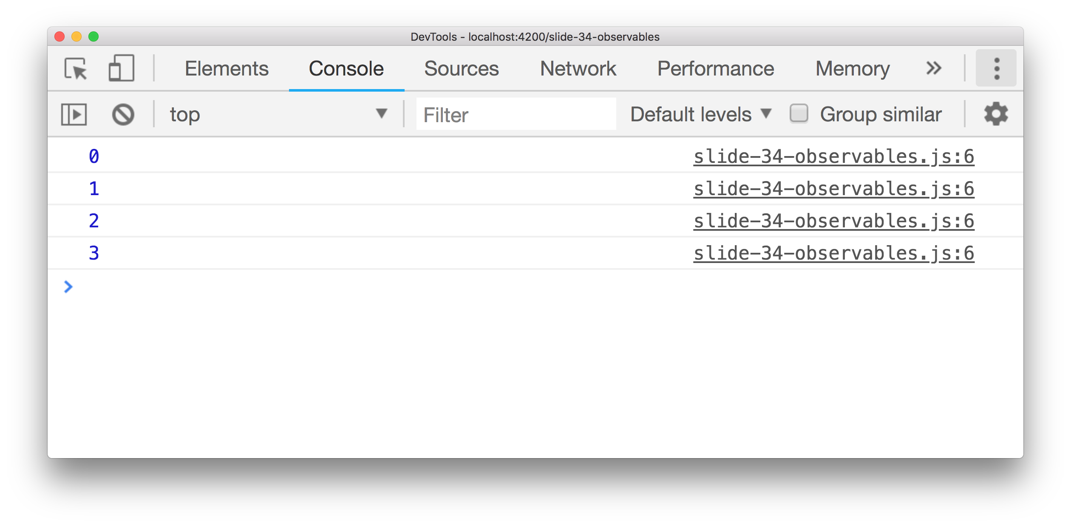
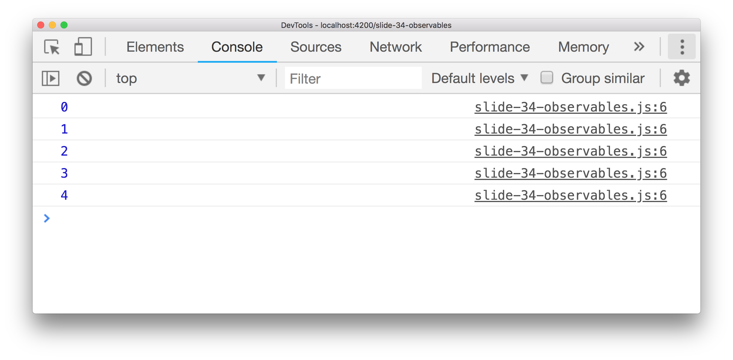
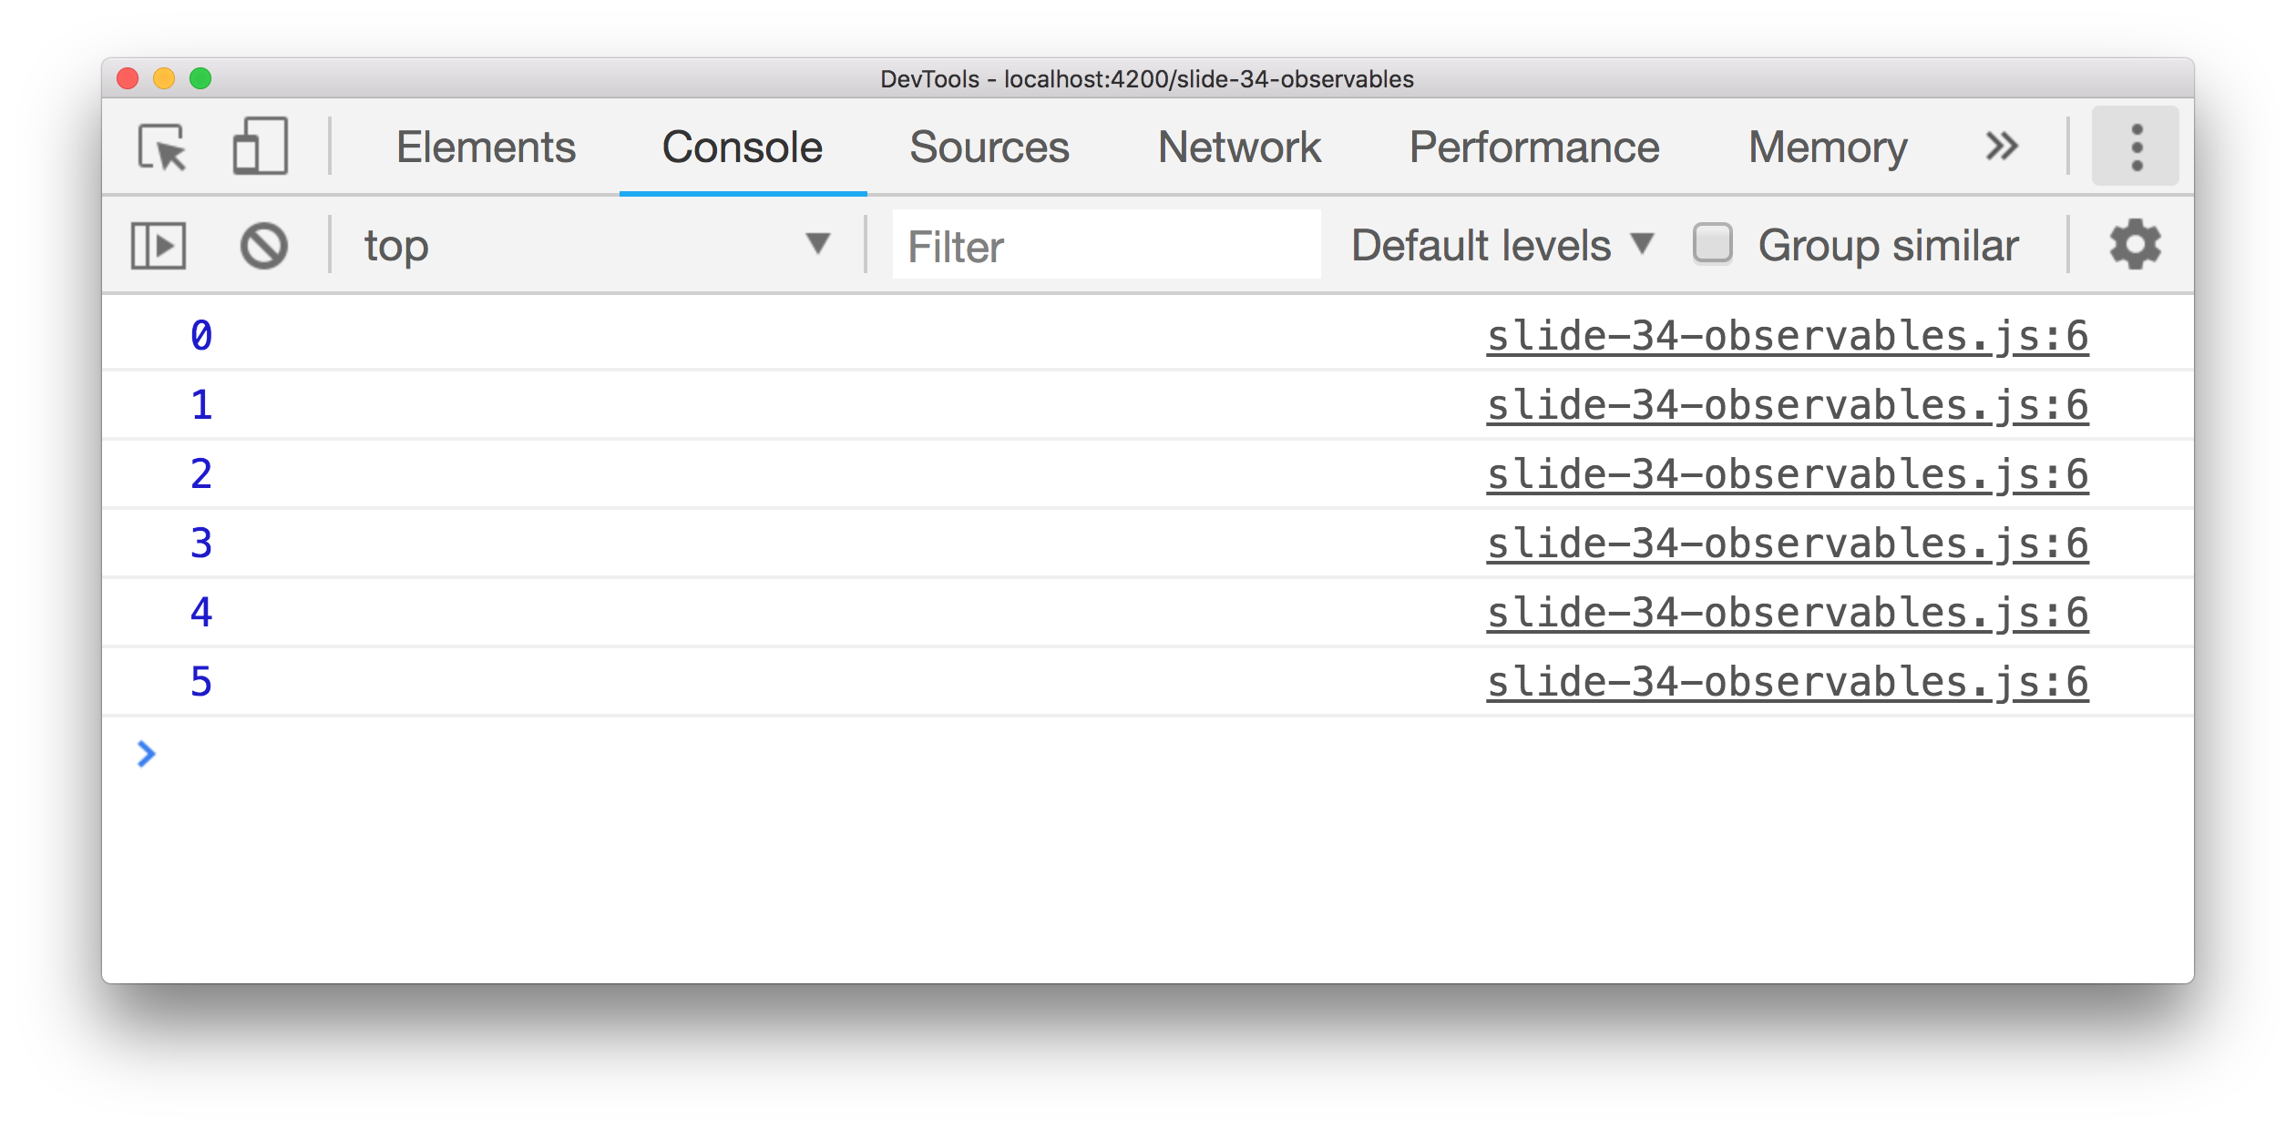
Example: multiple values
timer(0, 1000).subscribe(value => console.log(value))
Don’t forget to unsubscribe!

Slide 38
Observable
Something that emits events
Emit a value
Stop emitting values
End an error state
Observable
next(value)
complete()
error(err)
Notes:
Subscribe takes exactly these three parameters!

Slide 39
Observable
Emit a value
1
2
3
5

Slide 40
Observable
Emit a value
Stop emitting values
1
2
3
5

Slide 41
operators

Slide 42
Operators: map
1
2
3
5
map( x => 10 * x )
10
20
30
50

Slide 43
Operators: map
httpClient.get(endpointUrl)

Slide 44
Operators: map
httpClient.get(endpointUrl).pipe(
)

Slide 45
Operators: map
httpClient.get(endpointUrl).pipe(
map(repos => repos[0].name)
)

Slide 46
Operators: map
httpClient.get(endpointUrl).pipe(
map(repos => repos[0].name)
).subscribe(name =>
console.log(name)
);

Slide 47
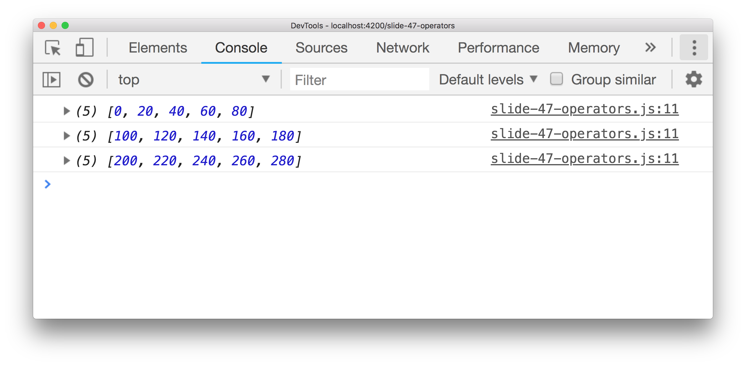
More operators
timer(0, 100).pipe(
map(x => 10 * x),
filter(x => x % 20 === 0),
bufferCount(5),
take(3),
delay(1000),
tap(x => console.log(x))
).subscribe();

Slide 48
Example: number of commits
Find the most recent GitHub repo I pushed to.
How many commits does it have?

Slide 49
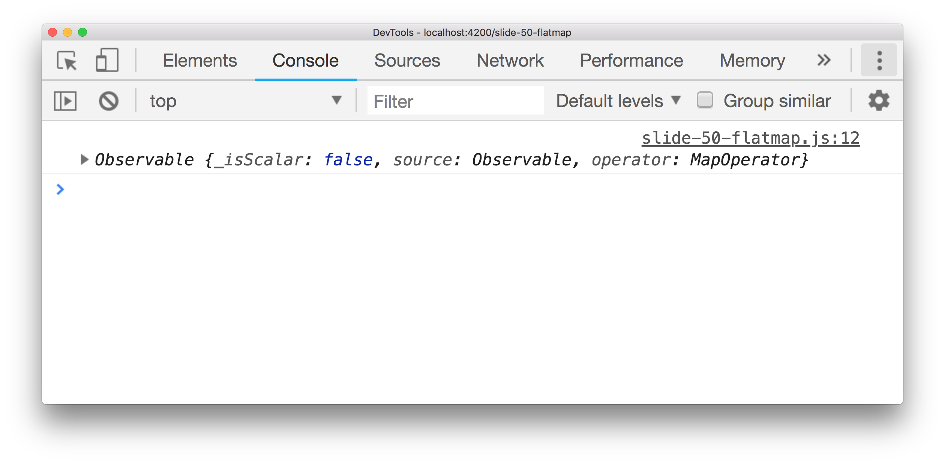
Operators: mergeMap
{
repo: 'abc'
url: 'xyz'
}
map(repo => httpClient.get(repo.commits_url))

Slide 50
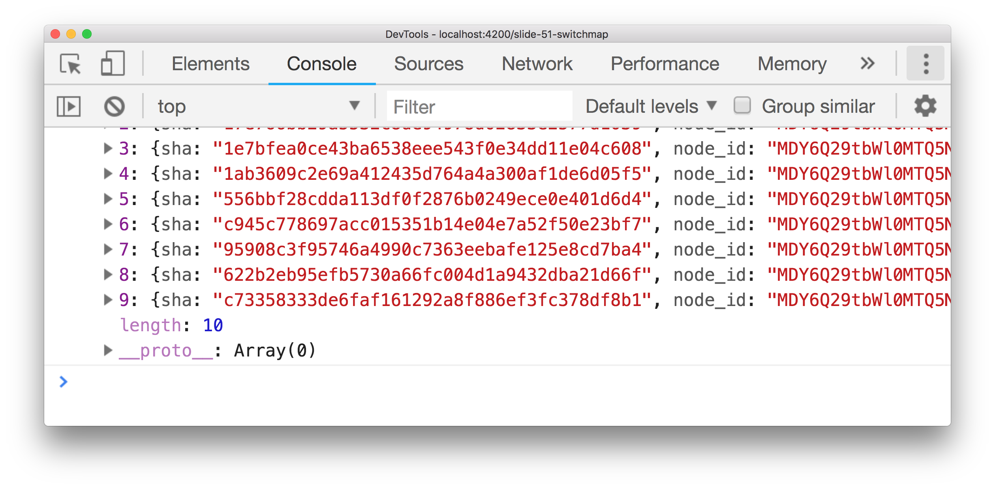
Operators: mergeMap
{
repo: 'abc'
url: 'xyz'
}
map mergeMap
[..commits]

Slide 51
Five operators like switchMap
flatMap
mergeMap
concatMap
switchMap
exhaustMap

Slide 52
Four operators like switchMap
mergeMap
concatMap
switchMap
exhaustMap
Source emits one value? Same effect!

Slide 53
Example: refresh on mouse click
Source observable => mouse clicks
On click => refresh data

Slide 54
Operators: mergeMap
click
click
mergeMap( http.get )
result
result
result
result

Slide 55
Preserve the order: concatMap
click
click
concatMap( http.get )
result
result
result
result

Slide 56
Cancel earlier requests: switchMap
click
click
switchMap( http.get )
result
result

Slide 57
Ignore later results: exhaustMap
click
click
click
exhaustMap( http.get )
result
result
result
result

Slide 58
Hot and cold observables

Slide 59
Hot Observable: already running
Observable
1
2
3
5
subscribe
3
5

Slide 60
Cold Observable: triggered by subscribe
Observable
subscribe
subscribe
1
1

Slide 61
Turning cold into hot: share operator
Observable
share
subscribe
subscribe
subscribe
1
1

Slide 62
Caching the values: shareReplay operator
Observable
shareReplay
subscribe
subscribe
subscribe
1
1

Slide 63
Should i use promises or observables?

Slide 64
You don’t have to choose!

Slide 65
You don’t have to choose!
Observable.from

Slide 66
You don’t have to choose!
Observable.from(getLatestRepo())
.subscribe(repo => console.log(repo.name));

Slide 67
You don’t have to choose!
Observable.from(getLatestRepo())
.subscribe(repo => console.log(repo.name));
.toPromise()

Slide 68
You don’t have to choose!
Observable.from(getLatestRepo())
.subscribe(repo => console.log(repo.name));
httpClient.get(endpointUrl).toPromise()
.then(repo => console.log(repo[0].name));

Slide 69
Should i use promises or observables?

Slide 70
Promises
Observables
Syntactic sugar async / await
Built into JavaScript
Imperative coding style
Easy to read code
Emit one value
Provided by RxJS
Functional coding style
Emit zero to infinite values
Powerful operators
Standard in Angular

Slide 71
Questions?
Michel Vollebregt
github.com/mvollebregt/techorama-2018
mvollebregt@ilionx.com
ilionx&qnh @ P2 (opposite catering)

